Slide 1

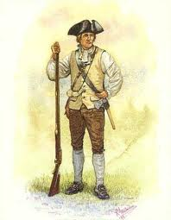
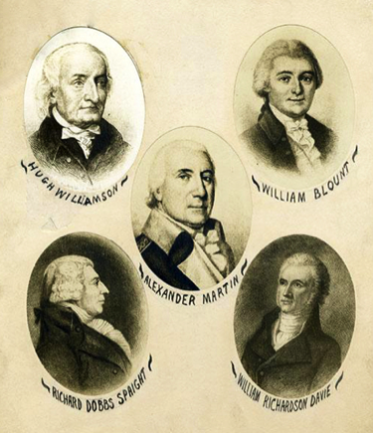
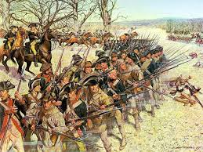
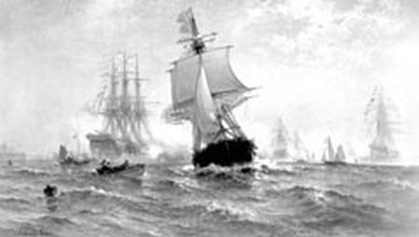
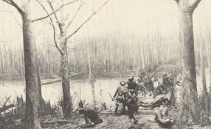
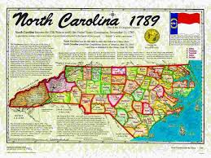
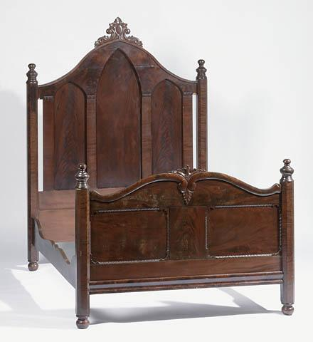
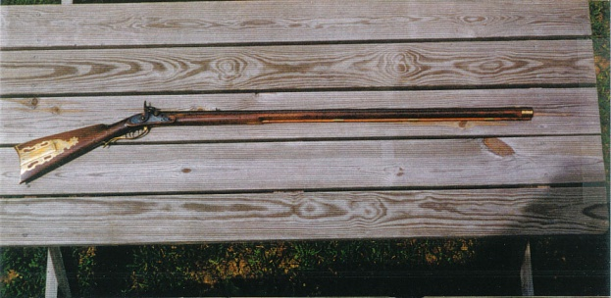
American Revolution
1763-1789

Slide 2
Overview
•American Revolutionary
War
1763-1789.
•The revolution means a forcible overthrow of a government or social order in favor of a new system.
http://dictionary.reference.com/browse/revolution

Slide 3
People
Richard Caswell- He led the patriots at the battle of Moores Creek Bridge. He was a member of the Continental Congress. He is also the NC’s 1st elected governor and the 5th governor.
http://ncpedia.org/biography/caswell-richard-0
David Kennedy (1768-1837): During the Revolutionary War era, he established the largest gun factory in the South, the Kennedy Gun Factory, in Moore County, NC. They made rifles, pistols, swords, and gun barrels.
http://ncpedia.org/biography/kennedy-david
Martha McFarlane McGee Bell: Mrs. Bell was a hero in the Revolutionary War era. She served as a nurse to those who were wounded. Cornwallis invaded her home to rest and feed his troops after Battle of the Guildford Courthouse. Shortly after his departure, she led the American troops to the British Camp.
http://ncpedia.org/biography/bell-martha

Slide 4
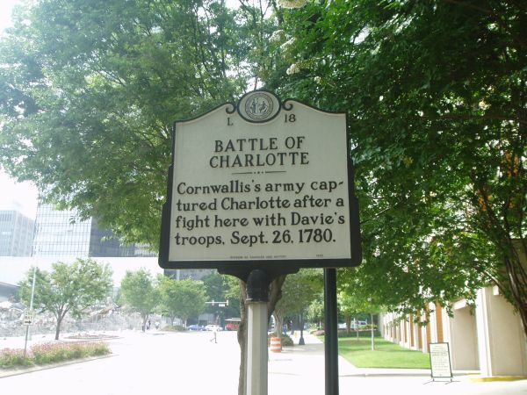
Major Conflicts
Sugar Act – reducing the duty on foreign molasses by half. North Carolinians viewed the Sugar Act as taxation without representation as well as an economic threat.
http://ncpedia.org/sugar-act
Battle of Charlotte- Cornwallis’s army captured Charlotte after a fight here with Davie’s troops, Sept.26.1780.
http://ncpedia.org/charlotte-battle

Slide 5
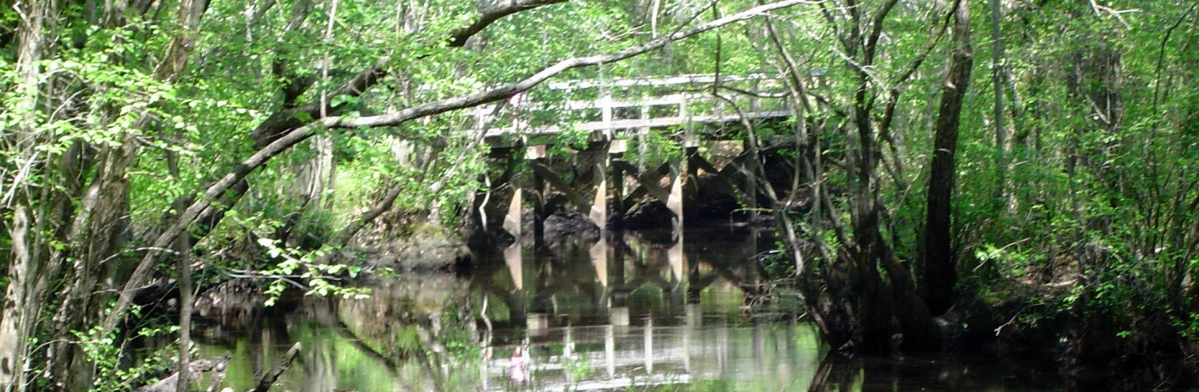
Major Events
The battle of Moores Creek Bridge in 1776 was the first millitary action in North Carolina and last near the end of the war.
http://www.history.com/topics/american-revolution/battle-of-moores-creek-bridge
The ‘’Old Burke,’’ Abingdon, and Elkin met at Morganton, North Carolina to prepare for the Battle of the Kings Mountian and Cowpens.
http://www.thehistorymuseumofburke.org/?page_id=37

Slide 6
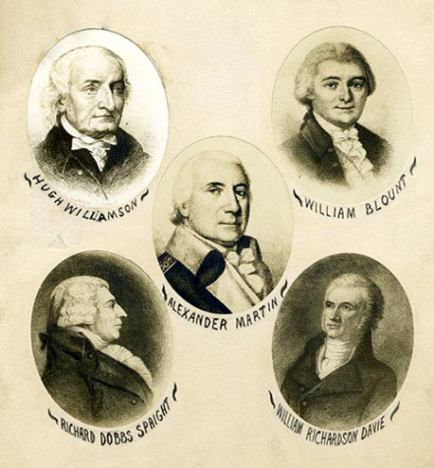
Government
The Stamp Act and Townshend Acts drew the growing radical element’s ire in particular and led to the emergence of a Sons of Liberty group in 1763.
http://archive.org/stream/johngrayblountpa04blou/johngrayblountpa04blou_djvu.txt
There were 5 founding fathers in North Carolina during the war, the founding fathers were Hugh Williamson, William Blount, Alexander Martin, Richard Dobbs Spaight, and Willam Richardson Davie.
http://ncpedia.org/constitution-us-north-carolina-sign

Slide 7
Agriculture And Indudtry
Furniture industries were built in different places in North Carolina and one of the most famous owners was Thomas Day and he was a very rare owner because he was a free black. His business was in Caswell County.
http://ncpedia.org/biography/day
John Gray Blount: Washington, Bertie County, NC – farmer, merchant, and manufactor. http://archive.org/stream/johngrayblountpa04blou/johngrayblountpa04blou_djvu.txt

Slide 8
Exploration And Growth
During the late 1700s, a growing Fayetteville in many ways become the political center of the State. A new courthouse and a jail opened in 1786.
http://www.northcarolinahistory.org/commentary/125/entry
On November 21, NC became the 12th state of U.S. of America.
http://www.enchantedlearning.com/usa/states/northcarolina/

Slide 9
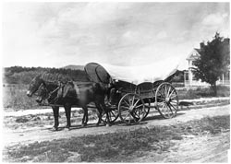



Transportation
The transportation back then were horse, buggies, Conestoga Wagon, wooden boats, Colonial Bateau, sail boats, wooden gunboats, and they walked.
http://ncpedia.org/gunboats-wooden
http://www.transchool.lee.army.mil/museum/transportation%20museum/revolutionary.htm

Slide 10

Technology And Inventions
Often North Carolinians invent corn shellers, cotton thinners, threshing machines, seed planters, gristmills, and agricultral tools.
http://ncpedia.org/industry/inventors
Muskets were important to north Carolina because they could shoot the gun and it would make a big smoke cloud then they would run to the enemy and stab them with the bayonet.
http://ncpedia.org/history/usrevolution/soldiers

